Slide 1
Lecture 5
Strings in ASM – part I

Slide 2
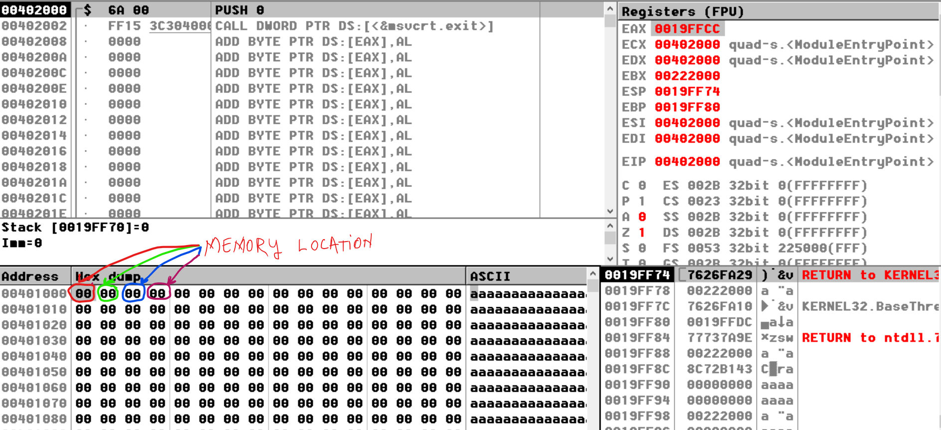
Memory Location
Each variable of byte type has 1 memory location.
Each memory location is numbered starting with 0 and this represent the address of the variable declared in data segment.
a db 0
b db 0
c db 0
d db 0

Slide 3
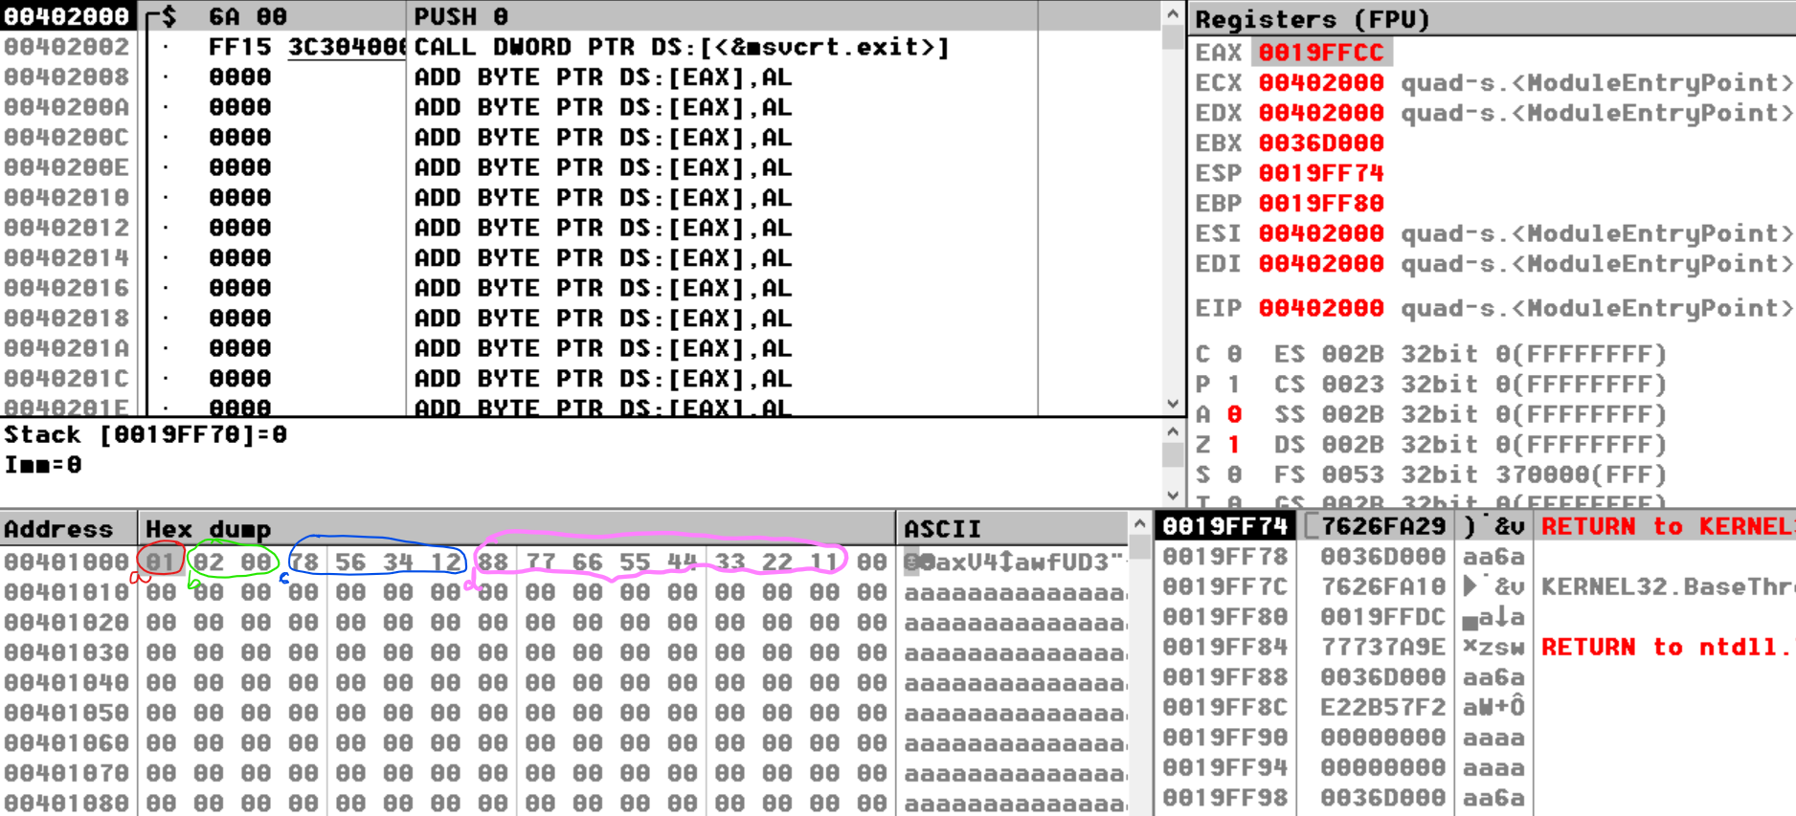
Each variable of word type has 2 memory location (because a word is formed from 2 bytes).
Each variable of doubleword type has 4 memory location (because a doubleword is formed from 4 bytes).
Each variable of quadword type has 8 memory location (because a quadword is formed from 8 bytes).
a db 1
b dw 2
c dd 12345678h
d dq 1122334455667788h

Slide 4
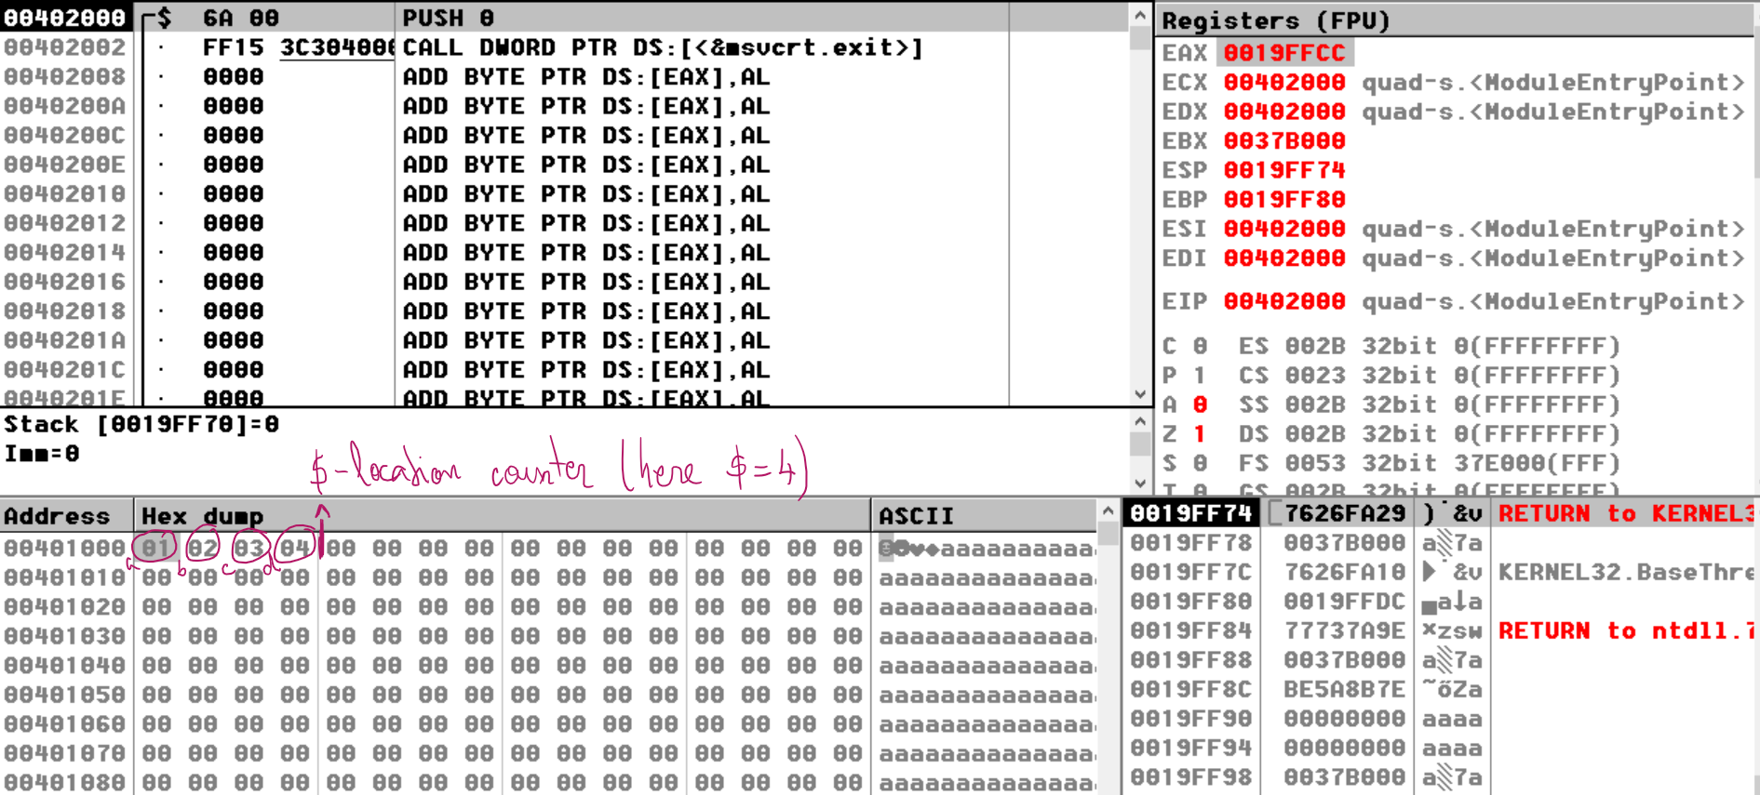
Location counter: $
location counter – an integer number managed by the assembler for every separate memory segment (in our case for data segment).
At any given moment, the value of the location counter is the number of the generated bytes correspondingly with the instructions and the directives already met in that segment.
The programmer can use this value by specifying in the source code the '$' symbol. The $ can not be modified.
a db 1
b db 2
c db 3
d db 4

Slide 5
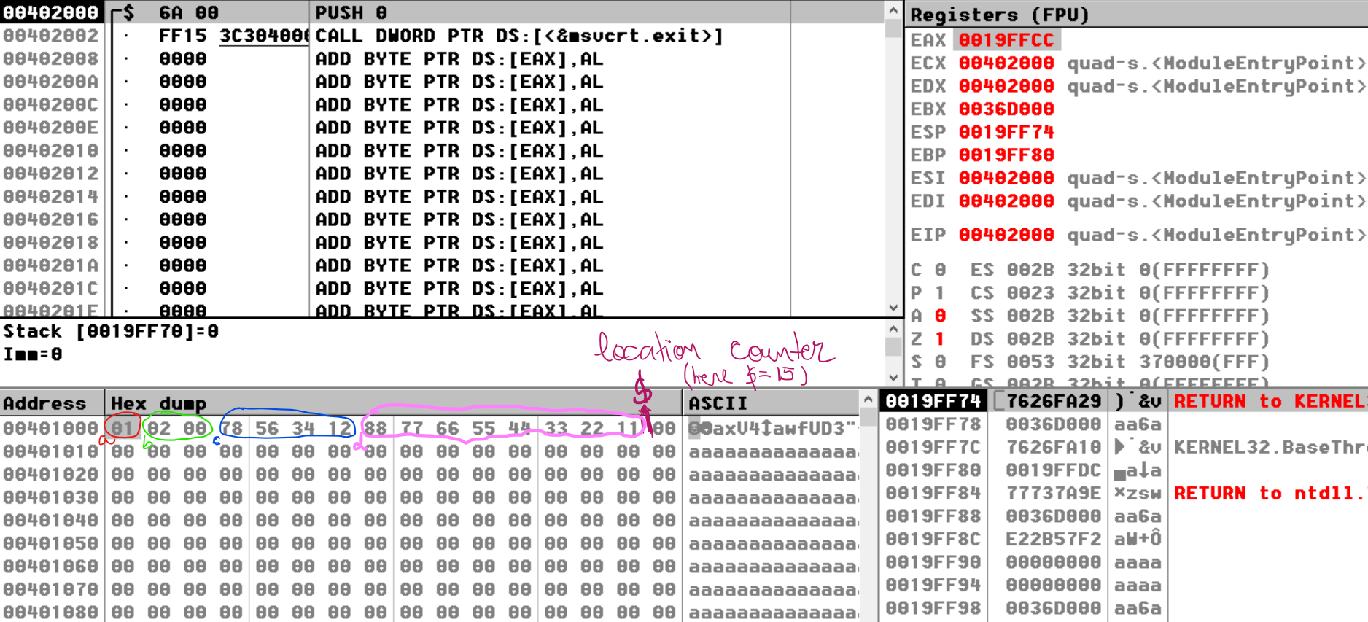
a db 1
b dw 2 ; 2 bytes = 2 memory locations
c dd 12345678h ; 4 bytes = 4 memory locations
d dq 1122334455667788h ; 8 bytes = 8 memory locations

Slide 6
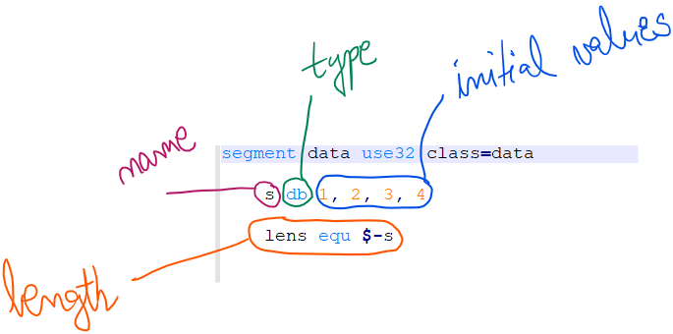
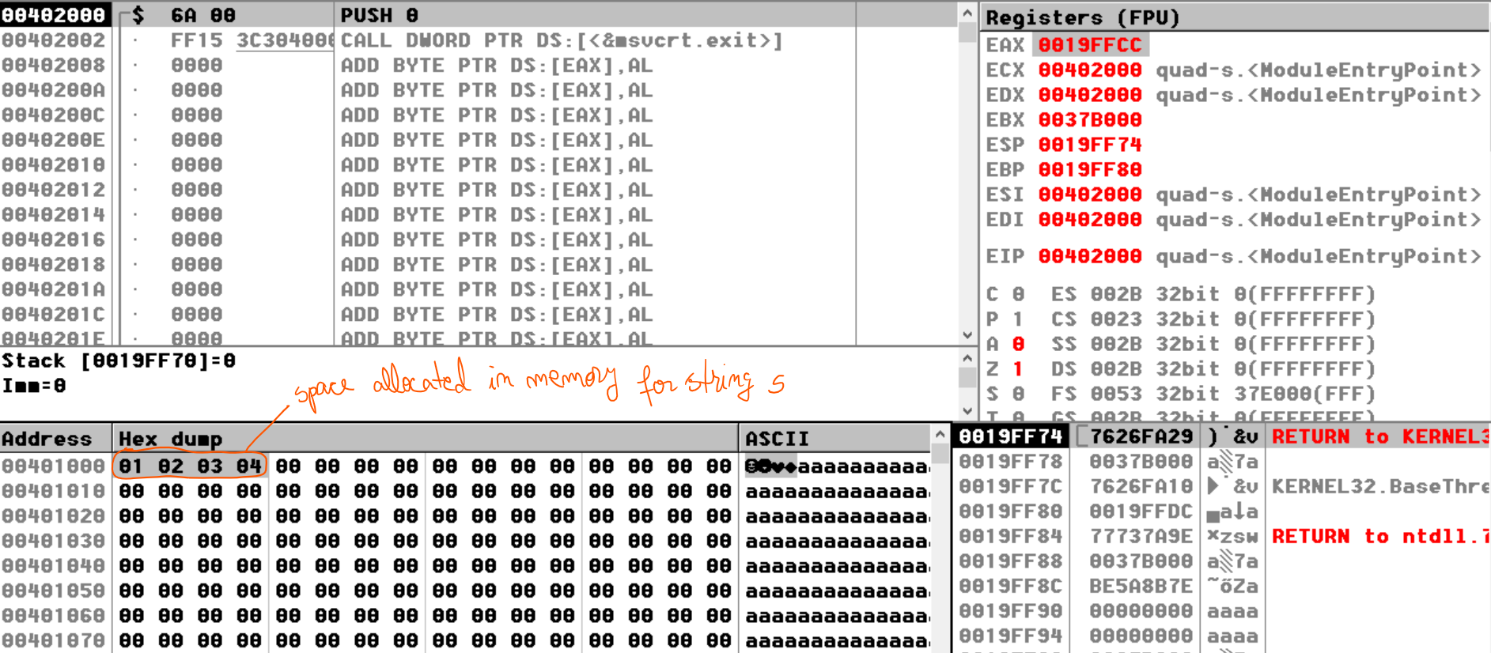
The definition of a string in ASM
A string in ASM has:
name
type
initial values
length
space allocated in memory

Slide 7
The name of a string
Has to start with a letter
Can not be a reserved word
Eg:
a
a1
string1
Ss_2

Slide 8
The type of a string
String of bytes
defined using DB
String of words
defined using DW
String of doubleword
defined using DD
String of quadword
defined using DQ

Slide 9
The initial values - Numbers
Numbers (any values in any base separated with a comma)
in base 10
eg: 1, 2, 3 or 1234, 1256
in base 2
eg: 010101b, 011b, 1111b
in base 16
eg: 0ABh, 0bh, 123h
For a string of numbers, the initial values could be in any base:
eg: 0101b, 123, 123h, -1
Characters (any character separated with a comma or not separated because one character is represented exactly on a byte)

Slide 10
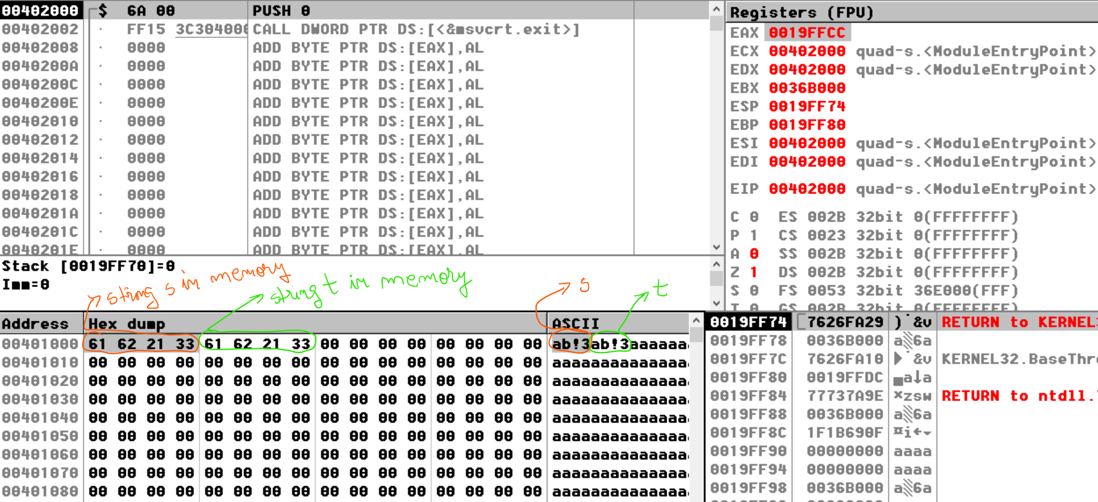
The initial values - Characters
Characters:
any character separated with a comma
Each character should be encapsulated between apostrophes
eg: s db 'a', 'b', '!', '3'
not separated – because one character is represented exactly on a byte
All characters should be encapsulated between apostrophes
eg: t db 'ab!3‘
The string s and the string t are equivalent.

Slide 11
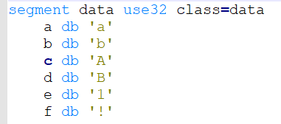
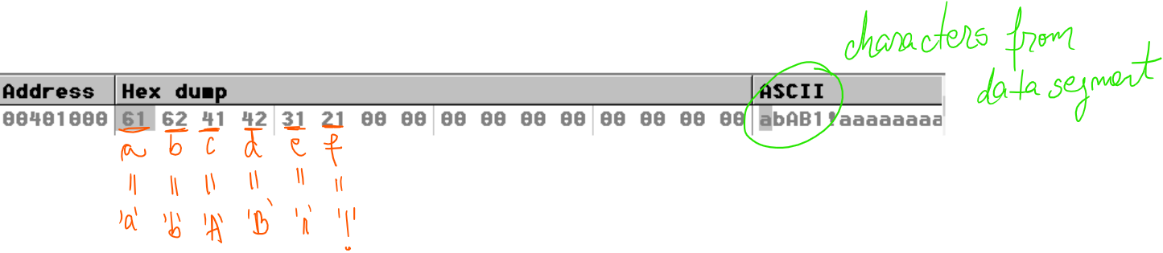
A character defined in data segment is saved in memory according to it’s equivalent of ASCII code.
The entire list of charcters and the equivalents ASCII code: https://www.asciitable.com/

Slide 12
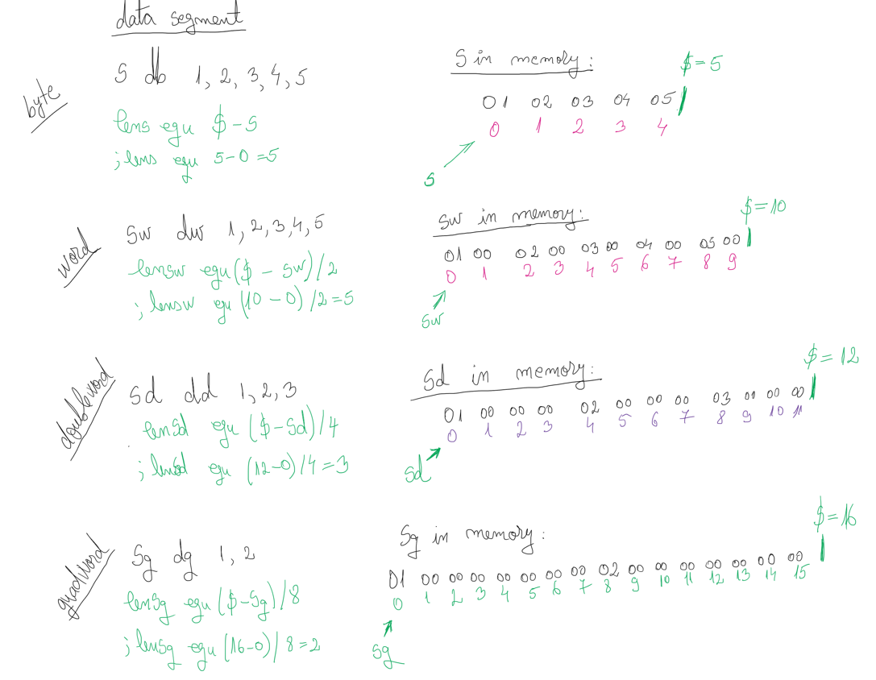
The length of a string
The length is computed using the location counter $ (sentinel character) and the directive EQU.
The EQU directive in .asm allows to assign a value to a variable in data segment without using a memory location to store that value (is a declaration without a definition in memory).
We perform a subtraction between the $ and the initial address of a string.
The $ - the number of generated bytes in memory until $ in encountered in code

Slide 13
The space allocated in memory
The space allocated in memory for each string is strict dependent of the type of string s.
string of N bytes defined in data segment has in memory N byes allocated
string of N words defined in data segment has in memory N words = N*2 byes allocated
string of N doublewords defined in data segment has in memory N doublewords = N*4 byes allocated
string of N quadwords defined in data segment has in memory N quadwords = N*8 byes allocated

Slide 14
Space for a string
For a source string (input string) the space is allocated step by step, base on each element from the string.
For a destination string (output string), we have to define the name, the type, the length and the initial values:
There are three ways (we assume the lens is a constant with value 10):
Reserve each byte: D DB 0, 0, 0, 0, 0, 0, 0, 0, 0, 0
Using RES directive: D RESB lens
Using TIMES directive: D times lens DB 0 or D times lens DB -1

Slide 15
Access an element from o string
Using the:
offset_address = [ base] + [ index × scale ] + [ constant ]
So offset_address is obtained from the following (maximum) four elements:
- the content of one of the registers EAX, EBX, ECX, EDX, EBP, ESI, EDI or ESP as base;
- the content of one of the registers EAX, EBX, ECX, EDX, EBP, ESI or EDI as index;
- scale to multiply the value of the index register with 1, 2, 4 or 8;
the value of a numeric constant, on a byte or on a doubleword.

Slide 16
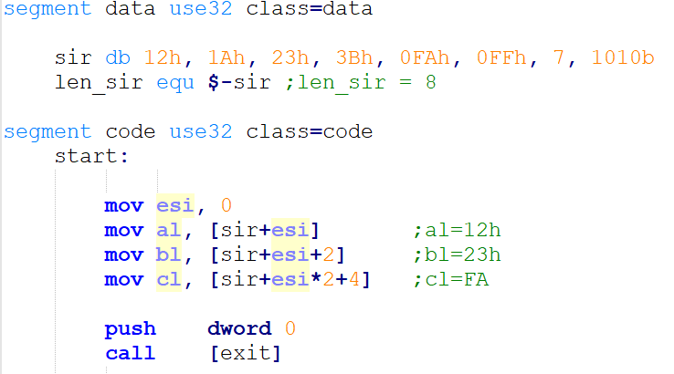
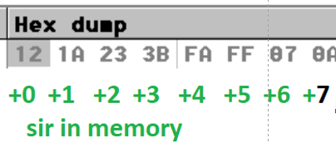
Using the formula of the offset to access a string element

Slide 17
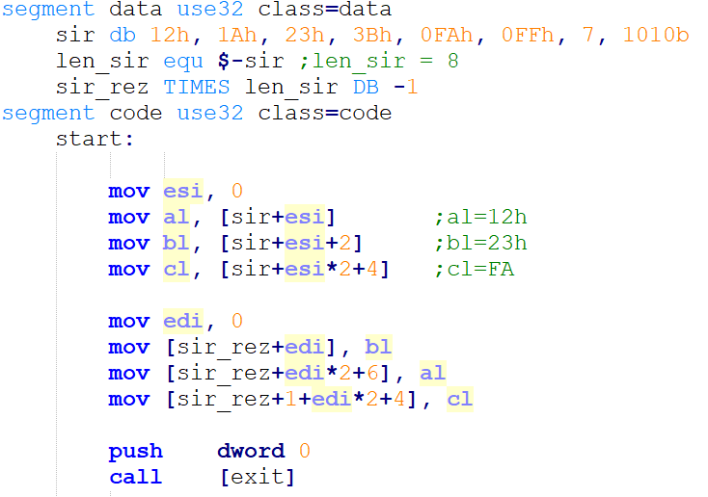
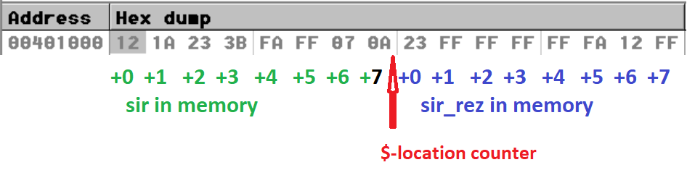

Slide 18
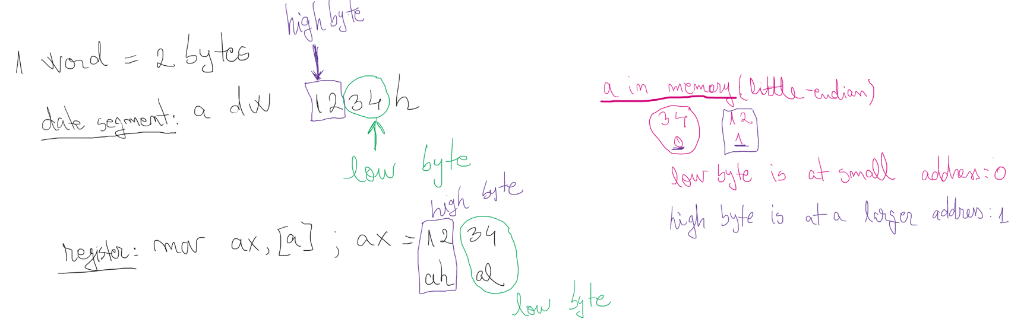
Word – one variable

Slide 19
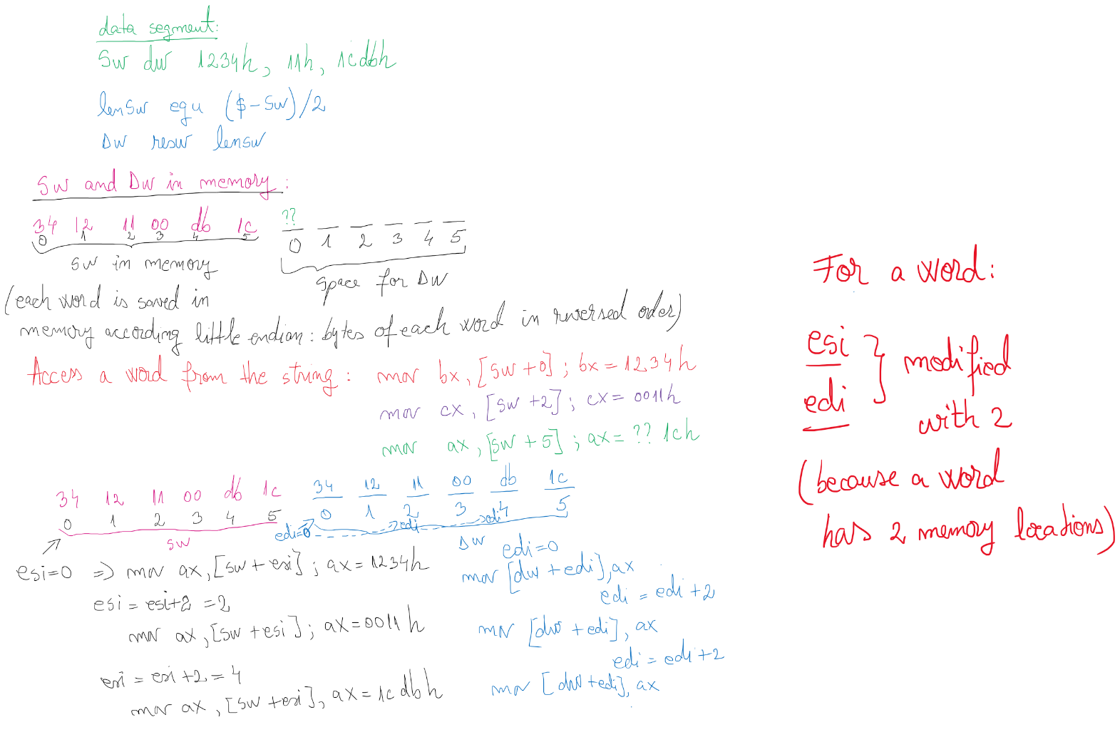
String of words

Slide 20
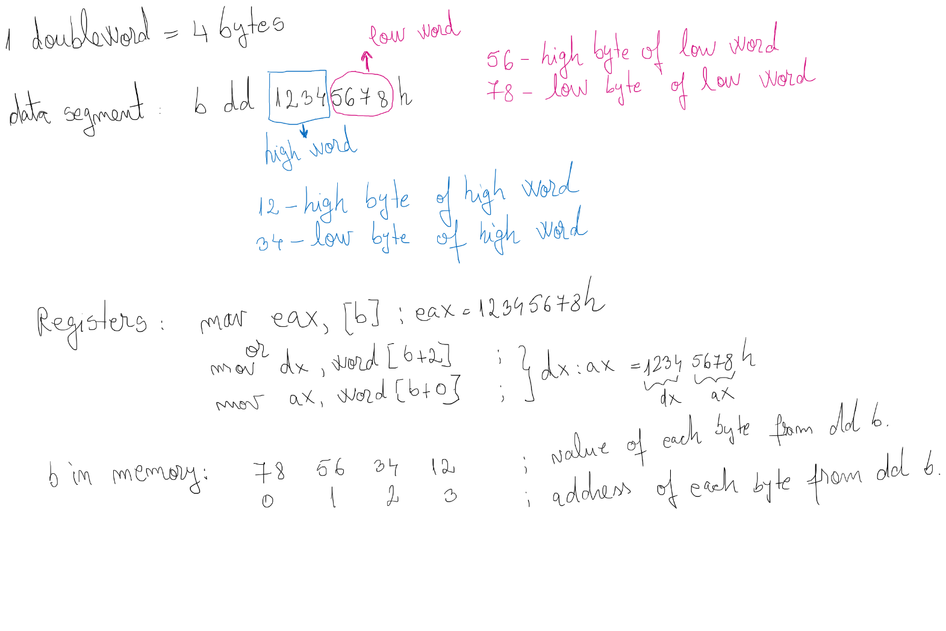
Doubleword – one variable

Slide 21
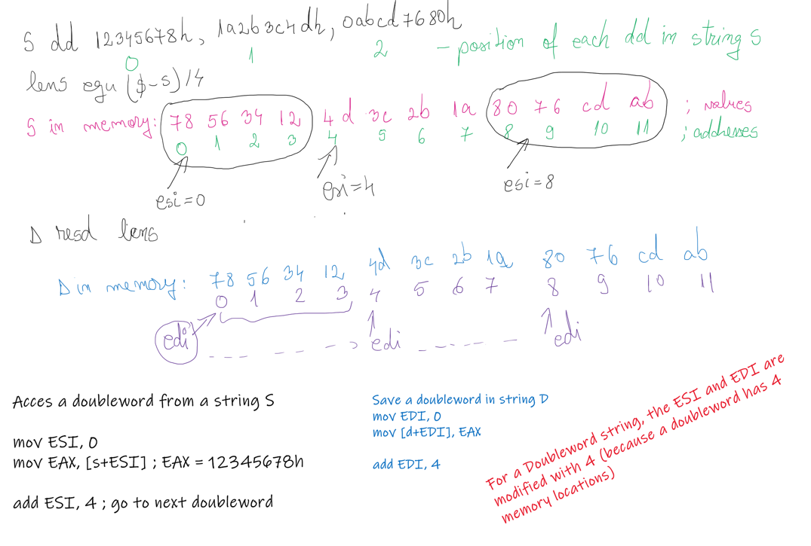
String of doublewords

Slide 22
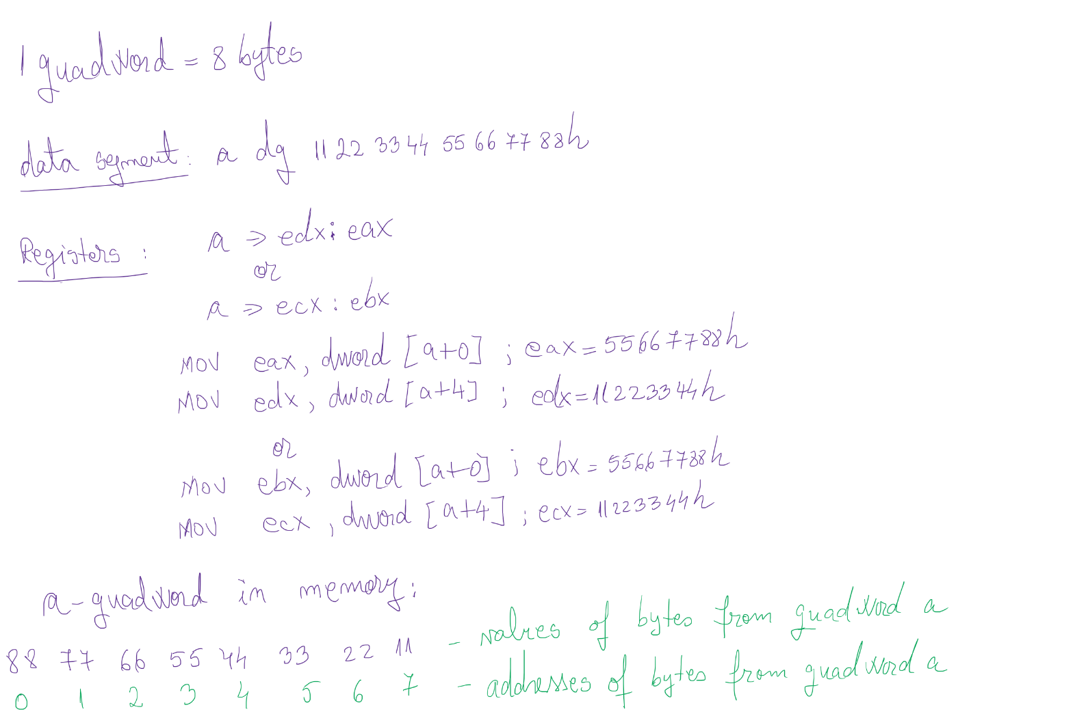
Quadword – one variable

Slide 23
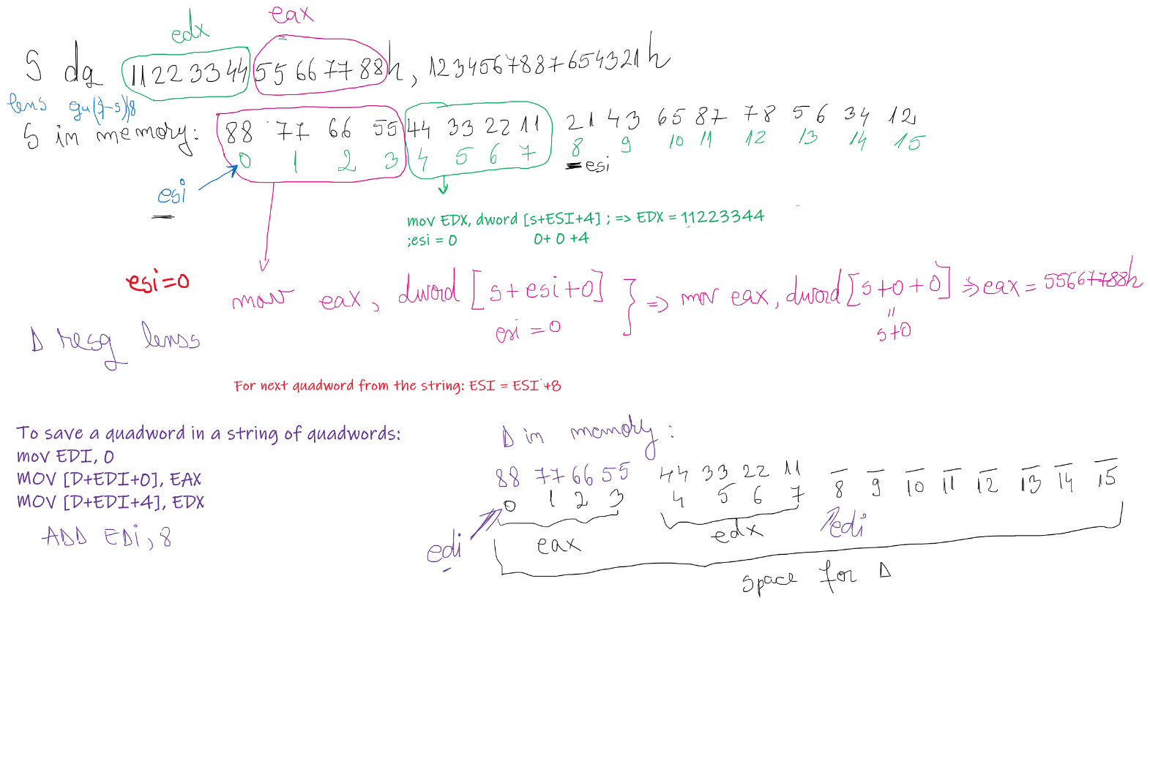
String of quadwords

